Slide 1
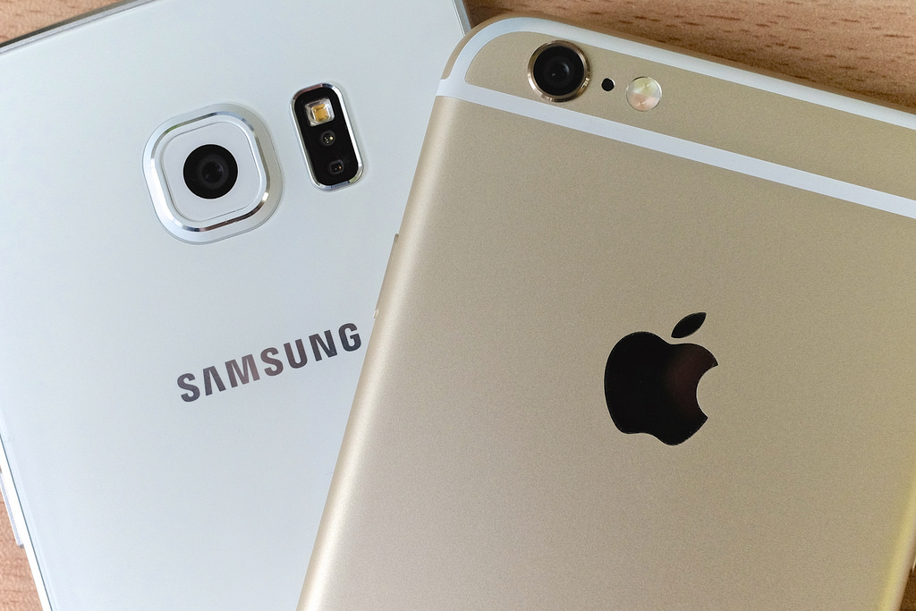
Amazon Web scraping
Apple & Samsung
Where data meets design

Slide 2

Collaborators Maira Syed Aruna Venkatachalam Jalees Moeen

Slide 3

Table of Contents
Introduction
Data Source
Web Scraping & Challenges
Data Cleaning
Flask Powered API
Data Visualization
Conclusion

Slide 4

Introduction
Amazon complements the tech experiences offered by both Samsung and Apple.
Online shopping define the modern intersection of technologies and convenience.

Slide 5


Data Source

Slide 6
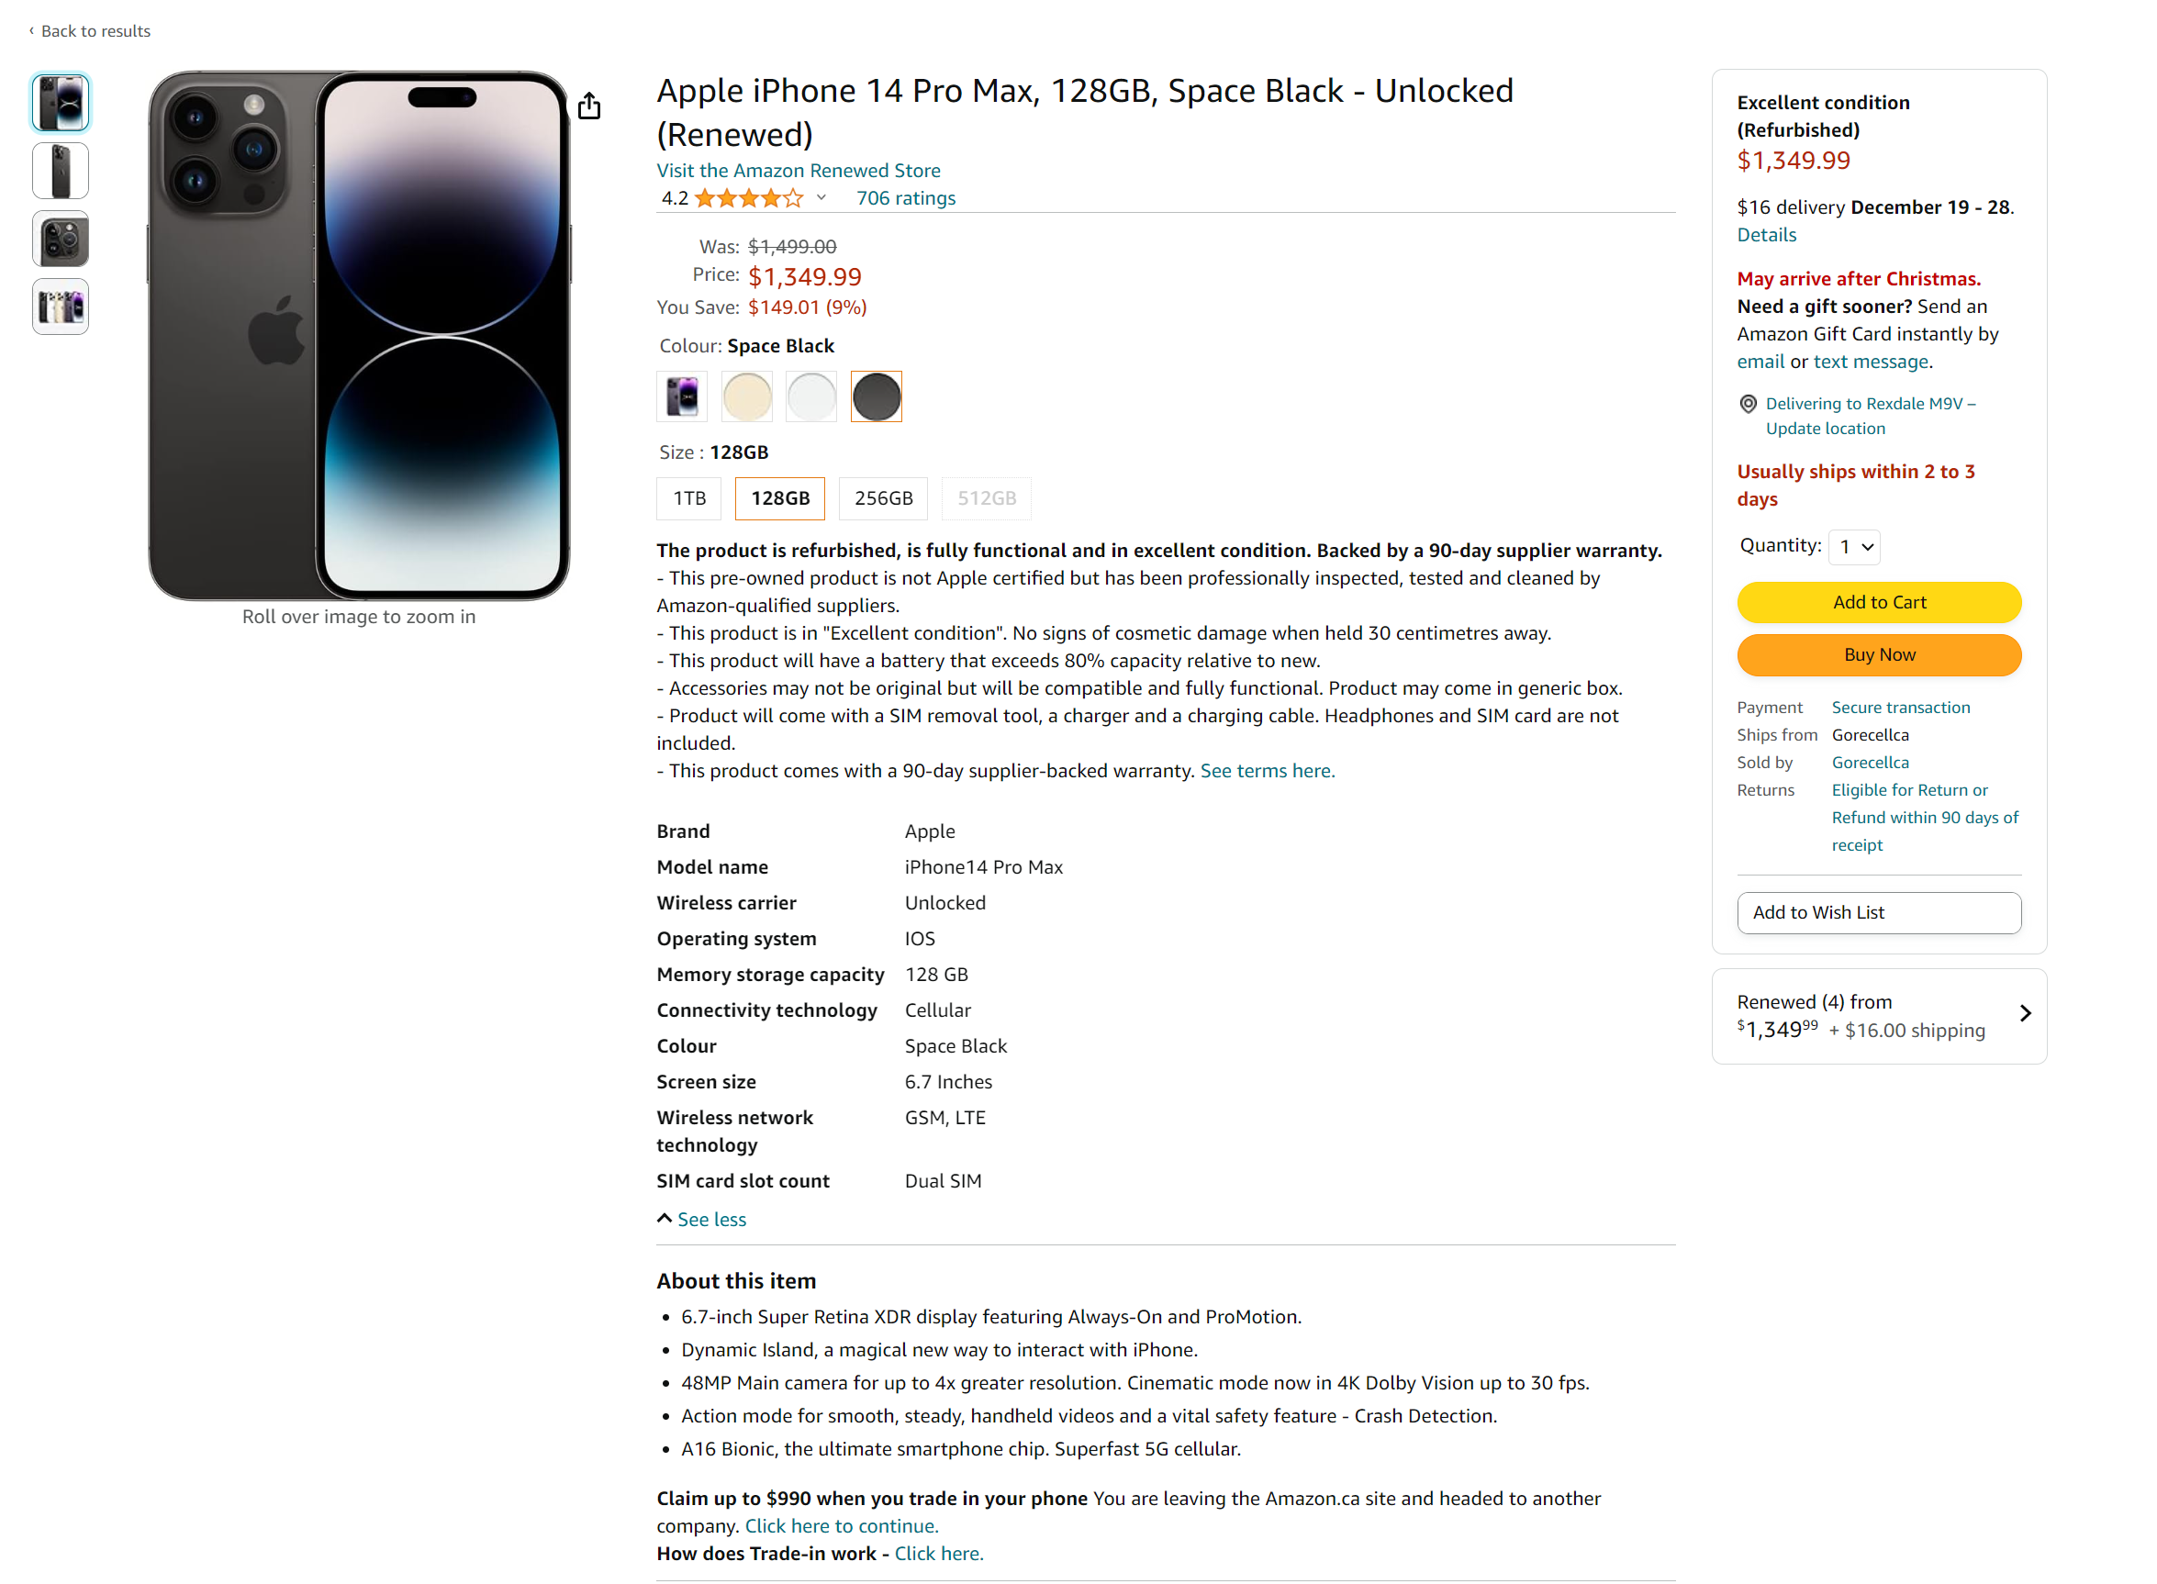

Slide 7
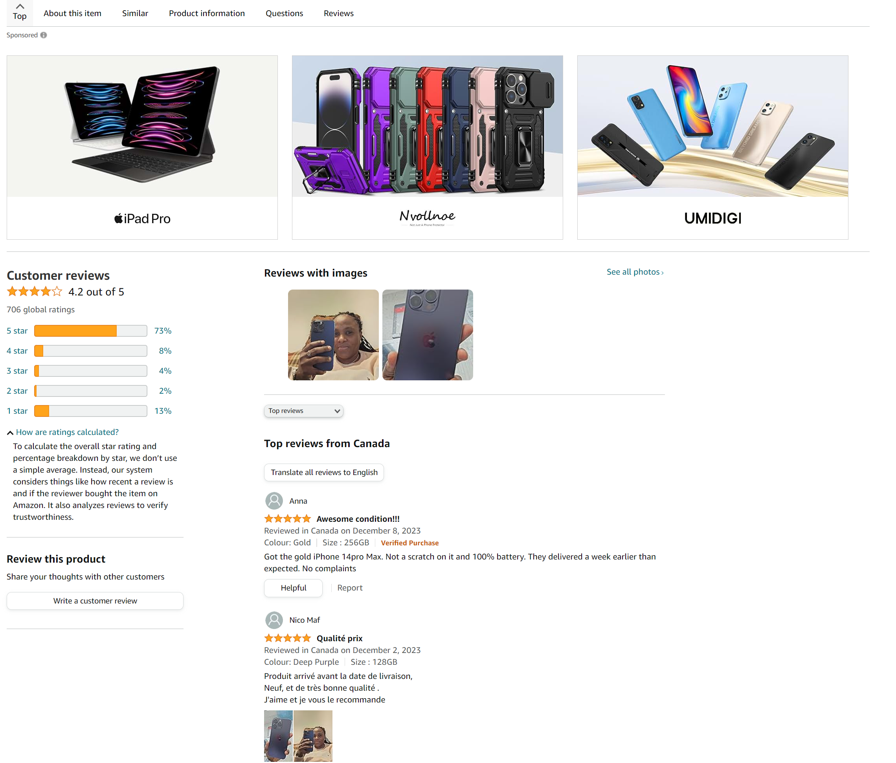

Slide 8
Web Scraping Challenges
Class name constraints
Dynamic contents in JavaScript
HTML structure changes
Notes:
We are unable to scrape the features data due to same class name for all the table
As the website is updating regularly there are changes in the site
HTML Structure Changes: Websites may undergo design changes, altering the HTML structure. Regular monitoring and updates to the scraping code are required to adapt to these changes.

Slide 9

Web Scraping
Defines a list of URLs for iPhone and Samsung products on Amazon
Systematic function for web scraping
Notes:
The function extracts product title, price, star ratings, number of global ratings, customer stars percentages, and features and ratings
The script showcases a systematic approach to web scraping
Defines a function scrape_amazon_product to extract relevant information from Amazon product pages using BeautifulSoup and requests.

Slide 10

Web Scraping
Defines dictionaries.
Loops through each brand's URLs.
Created appropriate data frames.
Notes:
The function extracts product title, price, star ratings, number of global ratings, customer stars percentages, and features and ratings
Defines a list of URLs for iPhone and Samsung products on Amazon. Defines a function scrape_amazon_product to extract relevant information from Amazon product pages using BeautifulSoup and requests. The function extracts product title, price, star ratings, number of global ratings, customer stars percentages, and features and ratings. It also contains a function extract_model_number to extract the model number from the product title. The script showcases a systematic approach to web scraping.
The script showcases a systematic approach to web scraping
Defines a function scrape_amazon_product to extract relevant information from Amazon product pages using BeautifulSoup and requests.
Defines dictionaries 'iphone_scraped_data' and 'samsung_scraped_data' to store scraped data for iPhone & Samsung products.
Loops through each brand's URLs, calls the scrape_amazon_product function, and stores the scraped data in the dictionaries. Saves the scraped data to JSON and CSV files.
Creates DataFrames 'scraped_iphone_df' and 'scraped_samsung_df' from the scraped data. Splits the 'title' column into multiple columns based on commas. Saves the modified DataFrames to CSV files

Slide 11
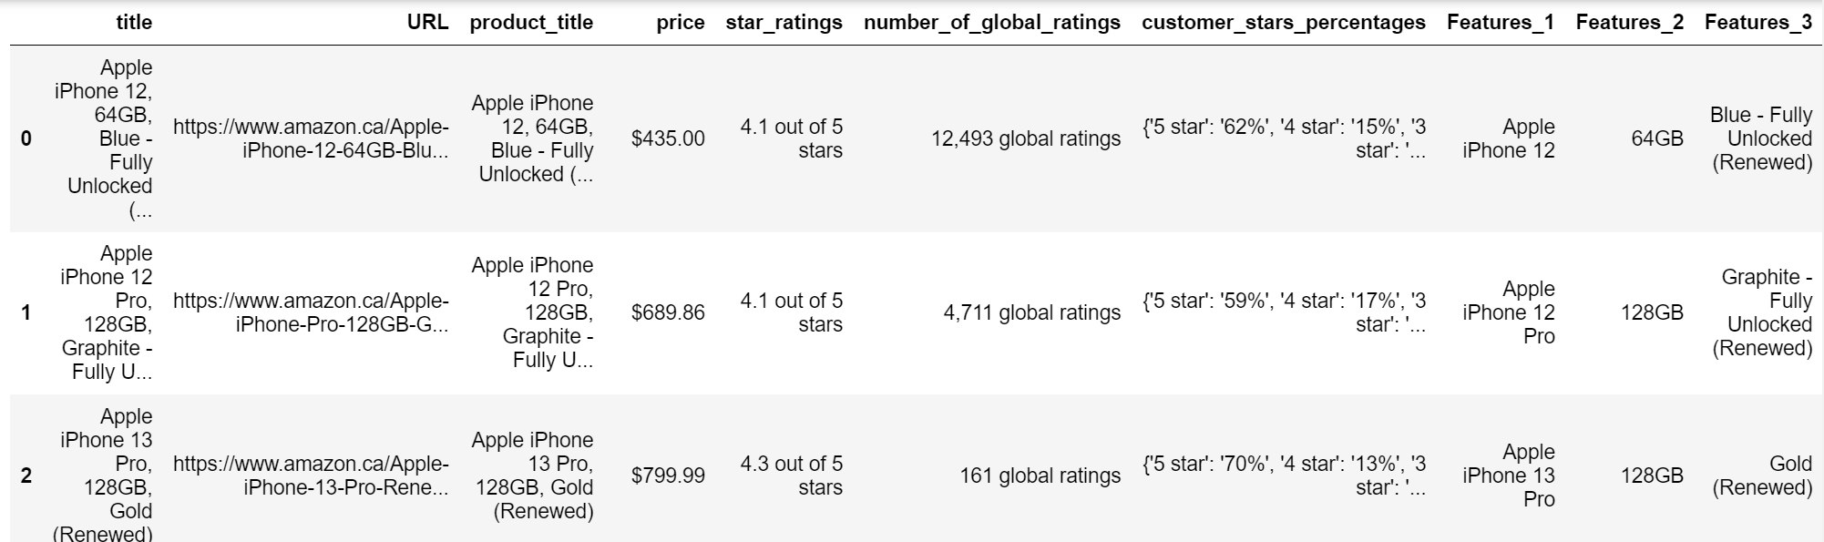
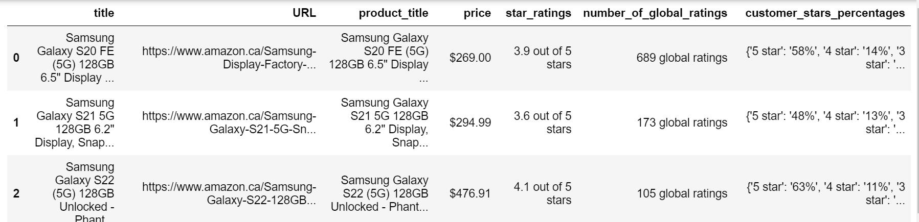
Notes:
The function extracts product title, price, star ratings, number of global ratings, customer stars percentages, and features and ratings
Defines a list of URLs for iPhone and Samsung products on Amazon. Defines a function scrape_amazon_product to extract relevant information from Amazon product pages using BeautifulSoup and requests. The function extracts product title, price, star ratings, number of global ratings, customer stars percentages, and features and ratings. It also contains a function extract_model_number to extract the model number from the product title. The script showcases a systematic approach to web scraping.
The script showcases a systematic approach to web scraping
Defines a function scrape_amazon_product to extract relevant information from Amazon product pages using BeautifulSoup and requests.
Defines dictionaries 'iphone_scraped_data' and 'samsung_scraped_data' to store scraped data for iPhone & Samsung products.
Loops through each brand's URLs, calls the scrape_amazon_product function, and stores the scraped data in the dictionaries. Saves the scraped data to JSON and CSV files.
Creates DataFrames 'scraped_iphone_df' and 'scraped_samsung_df' from the scraped data. Splits the 'title' column into multiple columns based on commas. Saves the modified DataFrames to CSV files

Slide 12
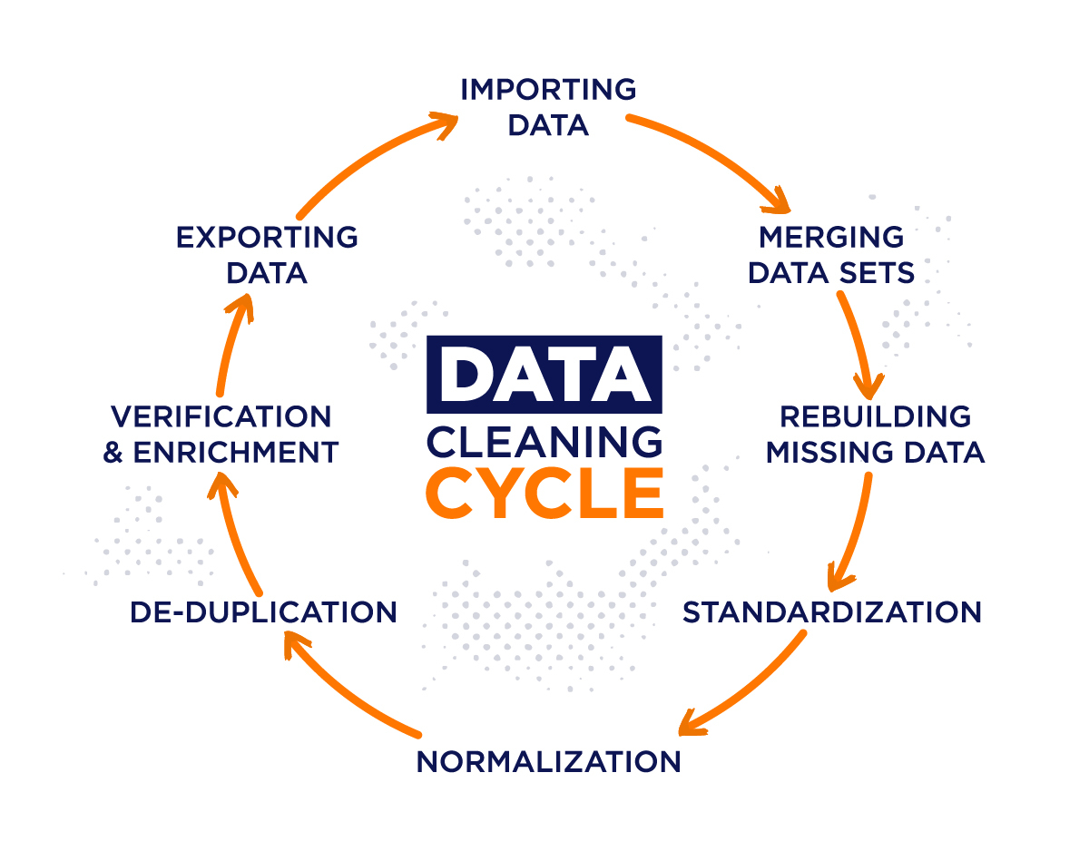
Data Cleaning
Regular Expressions
Extract and convert the columns
Data types
Notes:
The function extracts product title, price, star ratings, number of global ratings, customer stars percentages, and features and ratings
Defines a list of URLs for iPhone and Samsung products on Amazon. Defines a function scrape_amazon_product to extract relevant information from Amazon product pages using BeautifulSoup and requests. The function extracts product title, price, star ratings, number of global ratings, customer stars percentages, and features and ratings. It also contains a function extract_model_number to extract the model number from the product title. The script showcases a systematic approach to web scraping.
The script showcases a systematic approach to web scraping
Defines a function scrape_amazon_product to extract relevant information from Amazon product pages using BeautifulSoup and requests.
Drops unnecessary columns. Extracts and converts storage capacity, color, price, star ratings, global ratings, and customer stars percentages to appropriate data types using regular expressions. Creates new columns, including 'brand,' 'model_year,' and reorders columns with appropriate names. Saves cleaned 'iphone_samsung_df' data to JSON and CSV files.
Defines dictionaries 'iphone_scraped_data' and 'samsung_scraped_data' to store scraped data for iPhone & Samsung products.
Loops through each brand's URLs, calls the scrape_amazon_product function, and stores the scraped data in the dictionaries. Saves the scraped data to JSON and CSV files.
Creates DataFrames 'scraped_iphone_df' and 'scraped_samsung_df' from the scraped data. Splits the 'title' column into multiple columns based on commas. Saves the modified DataFrames to CSV files
We used Pandas and Regular Expressions to clean the data

Slide 13
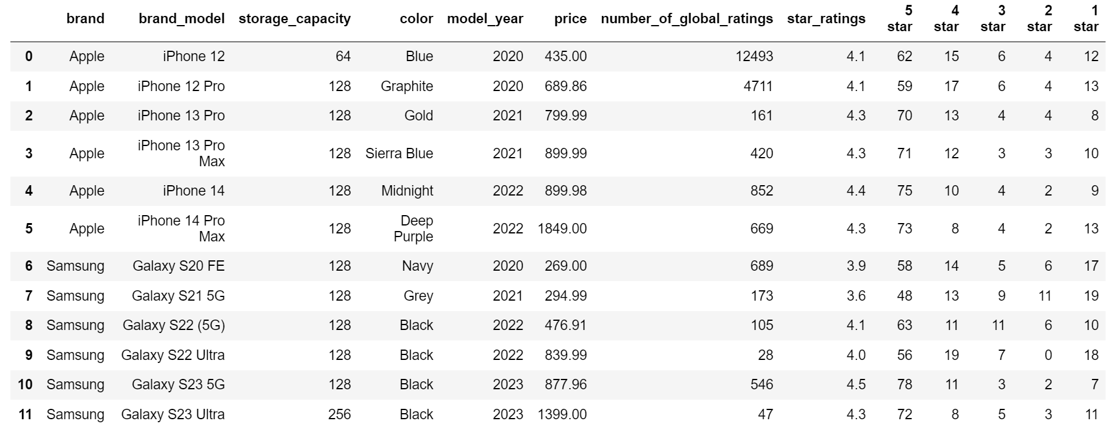
Notes:
The function extracts product title, price, star ratings, number of global ratings, customer stars percentages, and features and ratings
Defines a list of URLs for iPhone and Samsung products on Amazon. Defines a function scrape_amazon_product to extract relevant information from Amazon product pages using BeautifulSoup and requests. The function extracts product title, price, star ratings, number of global ratings, customer stars percentages, and features and ratings. It also contains a function extract_model_number to extract the model number from the product title. The script showcases a systematic approach to web scraping.
The script showcases a systematic approach to web scraping
Defines a function scrape_amazon_product to extract relevant information from Amazon product pages using BeautifulSoup and requests.
Defines dictionaries 'iphone_scraped_data' and 'samsung_scraped_data' to store scraped data for iPhone & Samsung products.
Loops through each brand's URLs, calls the scrape_amazon_product function, and stores the scraped data in the dictionaries. Saves the scraped data to JSON and CSV files.
Creates DataFrames 'scraped_iphone_df' and 'scraped_samsung_df' from the scraped data. Splits the 'title' column into multiple columns based on commas. Saves the modified DataFrames to CSV files

Slide 14

Flask App
Home Route
@app.route("/")
Data Route
/api/iphone_samsung_details
/api/iphone_details
/api/samsung_details
Notes:
Home Page Route (@app.route("/")): Renders the "index.html" template when users access the home page ("/").iPhone and Samsung Details API Routes: The below routes read merged iPhone and Samsung data from a CSV file, converts it to JSON, and returns it as a JSON response: /api/iphone_samsung_details /api/iphone_details /api/samsung_details

Slide 15

Data Visualization

Slide 16
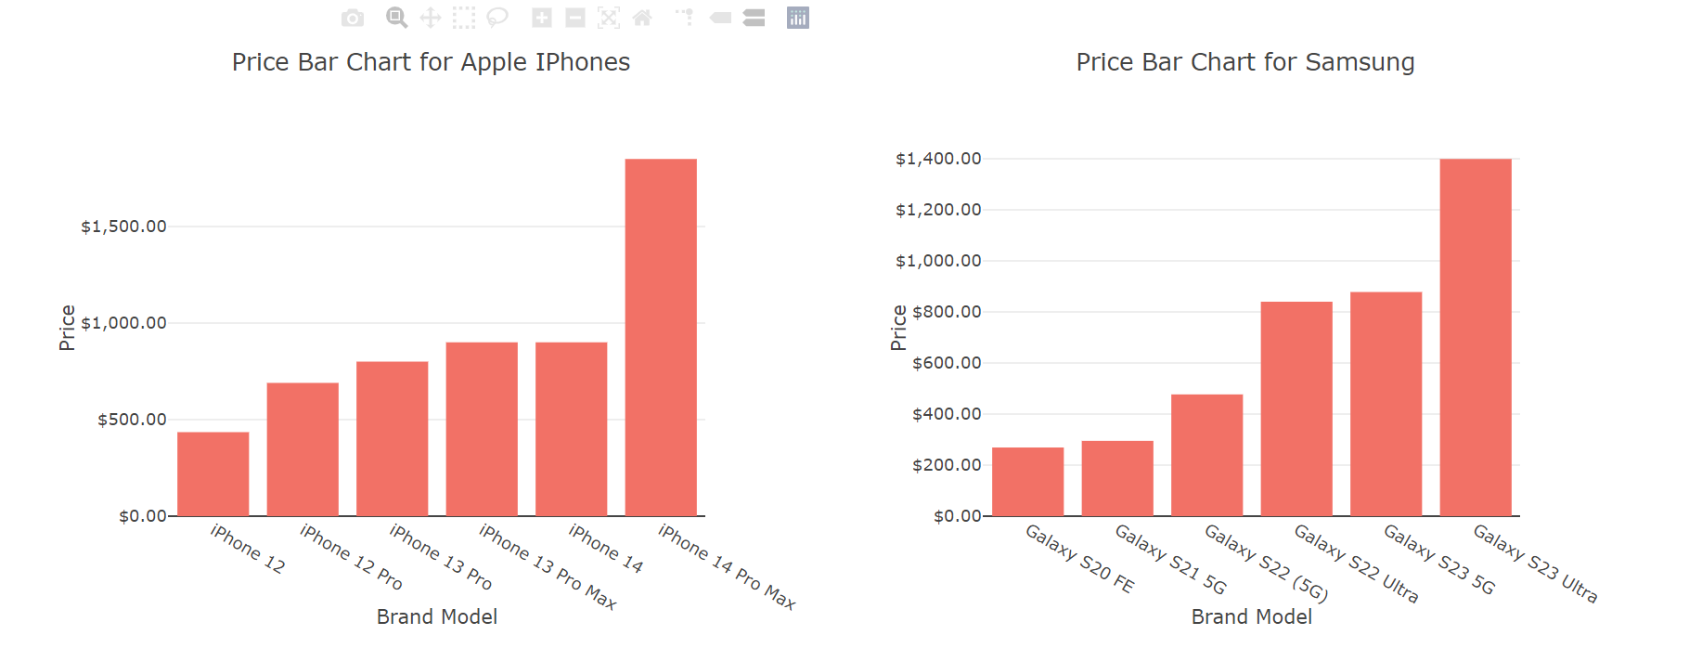

Slide 19

Limitation
Due to time constraints, we got limited data from web scraping
Apple data are comparatively less than Samsung.
We are unable to fetch few data as amazon websites often update their structure

Slide 20

Conclusion
Samsung mobile prices are comparatively lower than Apple.

Slide 21

Any Questions?

Slide 22
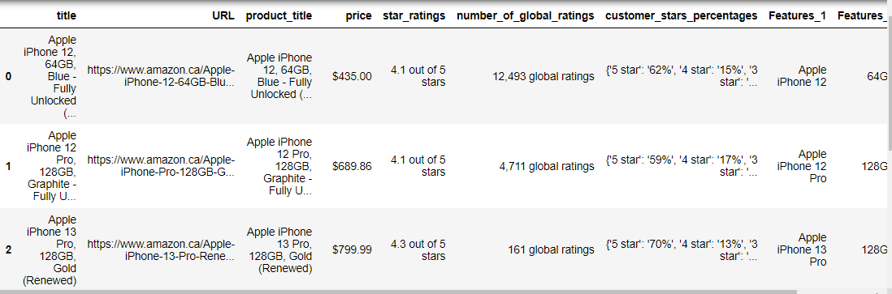
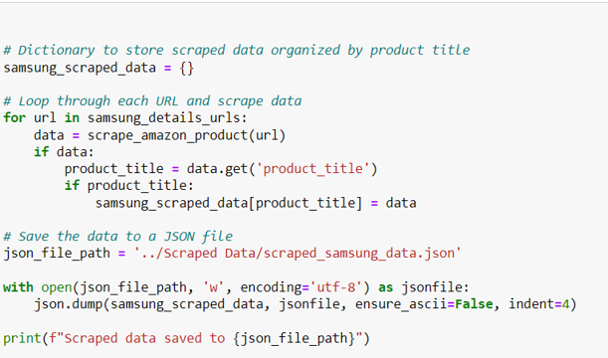

Slide 23
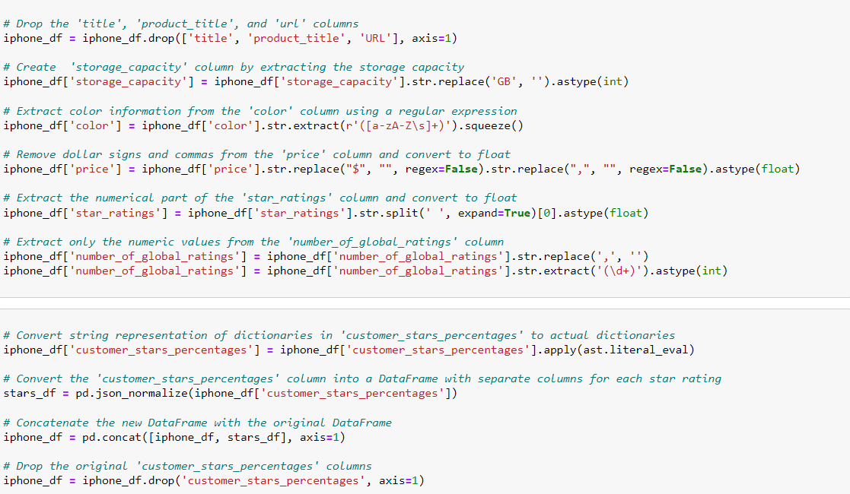
Data cleaning

